Slide 1
Roseville, formerly Leixlip Gate Lodge to Lucan Demesne: Part 1, The Toll House
Compiled by John Colgan ©
Augmented, 26/4/2021

Slide 2
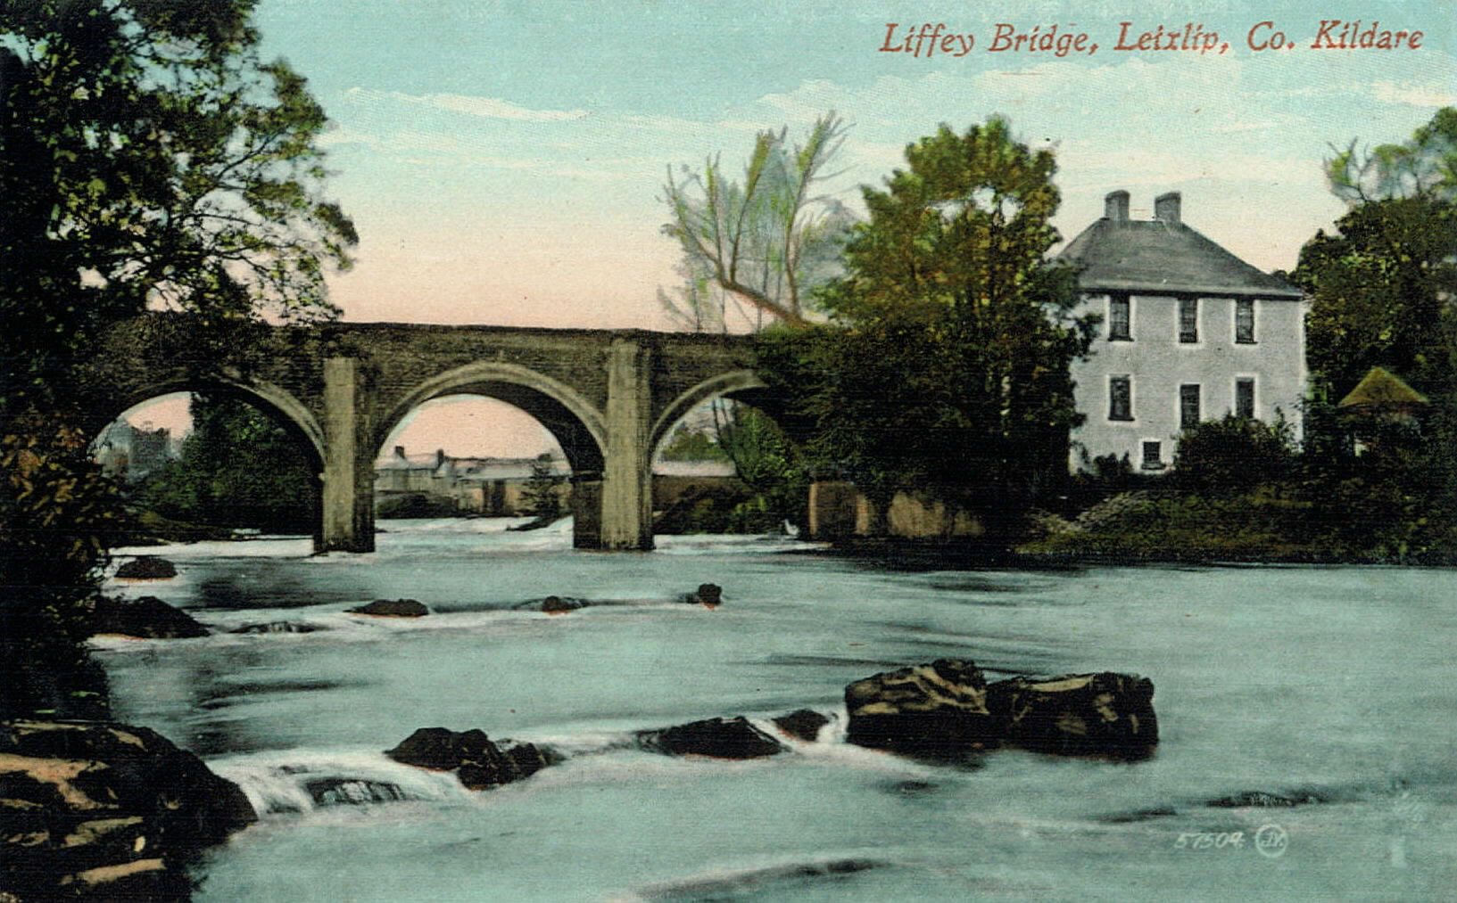
Liffey Bridge at Leixlip: a protected structure in Co Dublin (to left of central arch) and in Kildare for remaining 3.5 arches. The Toll House (shown here) is a protected structure in Kildare, RPS No. B11-44; NIAH Ref: 11804076, Leixlip
The Toll House is on a half acre gross site, a near rectangle from the river northwards and contained by the River Liffey near the containment wall, bridge wall and two block walls.
The projection of the site eastwards by the river’s edge is public parkland as a condition of the planning permissions on the nearby Castle Park enclave of ca 15 houses in Leixlip, Co Kildare. The park is approximately 15m wide from the escarpment to the river on the north bank.
This photo is from the Valentine Collection of ca 1900.

Slide 3

Composite View of Liffey Bridge, Toll House & Garden, 1990s. The Toll House (from ca 1730) is a protected structure in the Co Kildare Development Plan since this classification began, on or before ca 1971.

Slide 4
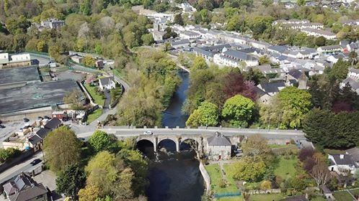
Aerial Drone photo, 1/5/2018, taken by Martin Blake for KCC. Roseville, as extended, is in bottom left hand corner. Shows tarmacked area. The Toll House, a 3 storey early 18th c house, is by Liffey edge and Bridge with river frontage to blue railing on river bank. The Liffey Valley extends to the Bridge and much of the timber on south bank, for conservation and extension in SDCC’s Development Plan, has been cut down since by or for Roseville owner/occupier.

Slide 5
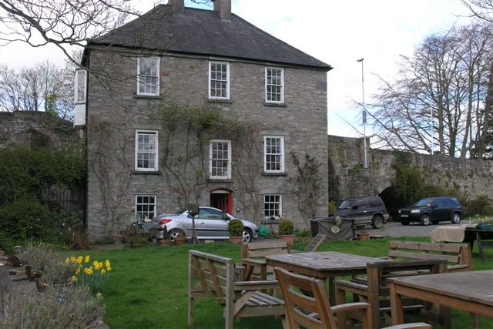
Toll House viewed from East, taken 5/9/2008. The oriel window on the 3rd storey overlooks the river. Hall door to Bridge, but red garden door is mainly used as the hall door opens directly onto a busy road (>12K vehicles a day)
Three planning permissions were obtained:
* In ca 1976 for general upgrade /conservation.
* In early 1990s to alter the ground floor windows and garden door to allow more light in.
* In 2017 to enclose the yard between the river’s edge and the rear of the house, with separate side entrance and drainage improvements to inhibit flooding.
The collapsed riverside wall was rebuilt and buttressed by a concrete path along it and a steps down to the path, all on the property which hitherto extended a few metres into what has been ‘handed back’ to the river.
The drive and parking area is all gravelled and french- drained.

Slide 6
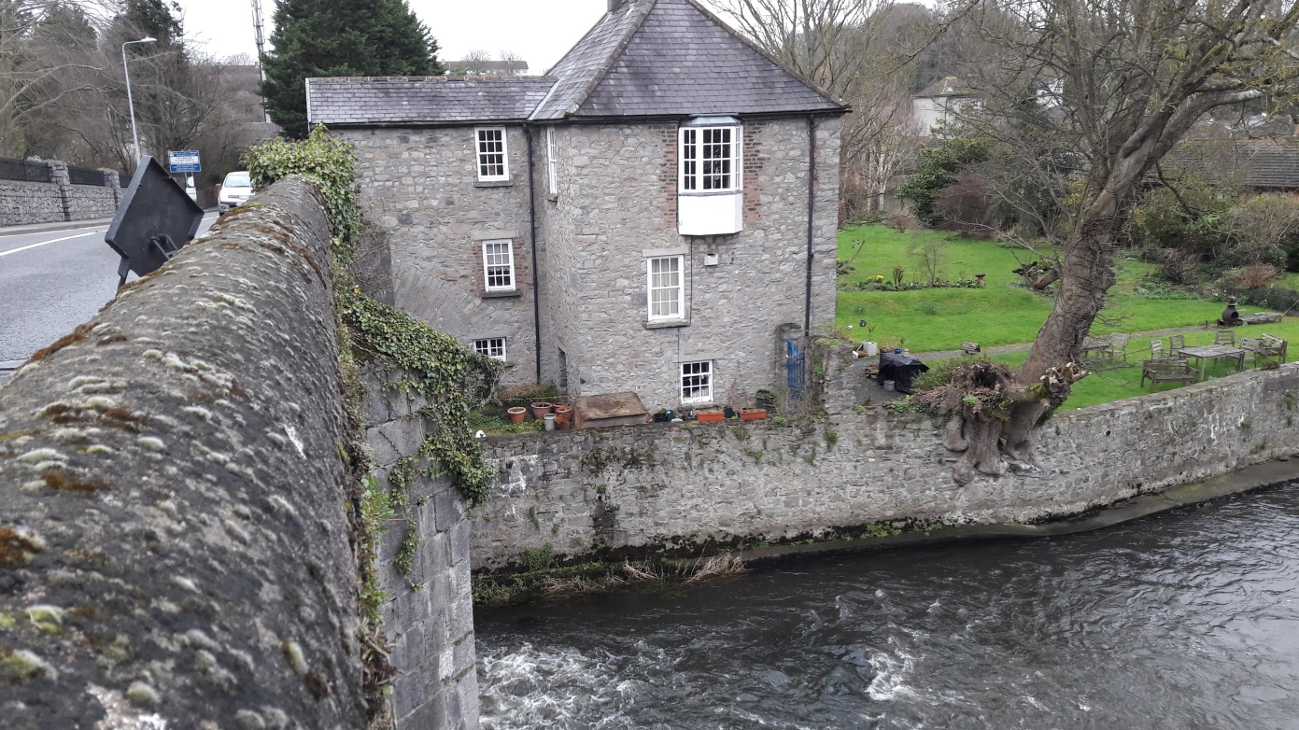
Toll House from the southerly direction, taken from Bridge wall while road drainage improvements were being undertaken by KCC. The large sycamore tree has been cut in two by surgeons, consequent on a bough breaking off and holing a slate in the roof.
The yard on extreme left has been recently roofed over and lighted, with the benefit of planning permission. The drain in the wall, indicated by the dark stain, has been eliminated.
There are two other sycamores in the garden. One, near to neighbouring property, has, on the advice of a tree surgeon, Shane Petrie, been reduced by one third in height. All three sycamores are about 200 years old.
The Toll House was built contemporaneously with the Toll Bridge as part of the Dublin to Kinnegad Turnpike Act, 1729, scheme. Part acts as a buttress for the Bridge; the rear portion of the house was added some 13 years later.

Slide 7
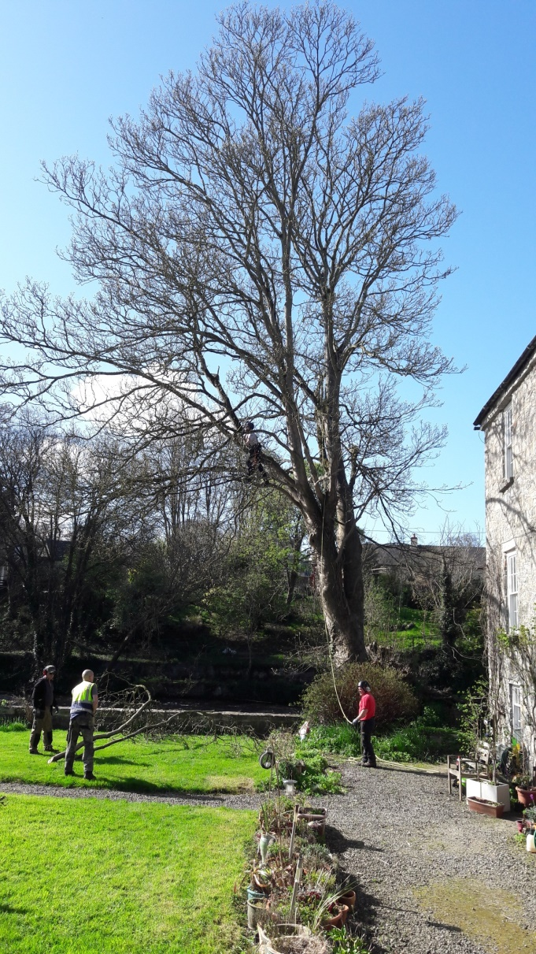
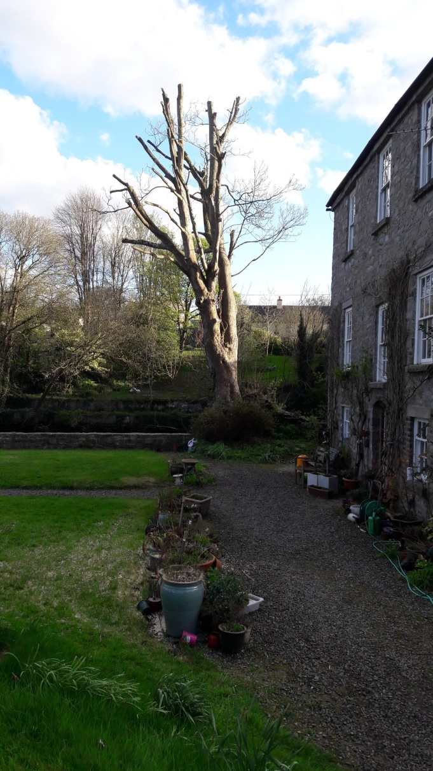
Riverside Sycamore tree before and after cut, 20/4/2018

Slide 8
Toll House Details
The gross internal space is 2,000 sq feet. Much is taken up with large footprints for two chimney breasts and staircase.
The extension added ~305 sq ft to the area.
In addition, there are 2 tunnels, 20ft by 12ft, under the bridge road which belong to the property
There’s a small green house and the garden has been extensively cultivated in flowers and shrubs.
We’ve owned the House since October, 1991.
The House was valued by two reputable valuers in 2007 at between €1.1 and €1.4 million, before the extension was added.
Prior to the recent works – unauthorised works – on Roseville opposite, the Toll House and garden enjoyed privacy from the southerly direction. Privacy was effected (for both properties) by a wildly wooded area covering the escarpment down to the river wall and extending above the plateau which comprises Roseville’s lawn. This constitutes part of the Liffey Valley the preservation of which is part of the SDCC Development Plan.
No Roseville building could be seen and only the space immediately above the lawn to the east was visible through trees.
The remainder was a wooded wilderness.
There were no functioning steps or stairs down the centre of the embankment and no bright stair rail.

Slide 9
Roseville Developments…
A woman, announcing herself as Lara Lenehan drove into the Toll House without notice on 21/3/2017 and asked to hear my views on KCC’s proposals for repairing the bridge wall which terminated their site (as I understood it, before reflecting on it) on the west side. They were already in residence in Roseville and she said they were applying for PP for an extension and would show me the plans. They didn’t show plans. She said they would apply in her name; they didn’t, they applied in her husband’s, Justin Winston’s name, and used an irregular address and wrong county on the site notice, an incorrect newspaper notice and a different county on the application form.
I wrote her an emailed letter dated 5/5/2017, having eventually seen the plans on the web and said I found nothing of an objectionable nature in the proposed development. I noticed that her agent, Paul Redmond (not an architect?) stated that the development “won’t have adverse impact on the proposed Natural Heritage Area”.
I mentioned our desire that the green wooded ambience of the Liffey Valley, which we had enjoyed for 25 years should continue and said that I suspect SDCC ‘s Development Plan may have something to say about keeping it a preventing development on it. When I did look, I found this to be the case. No development of any kind would be permitted within 30m of the Liffey’s edge in order to protect the recreational amenity. The wooded Liffey Valley to be carefully preserved etc.
More….
Ms Lenehan provided her mobile phone and email address on one of my business cards when she called in March; I retain it.
When the works on Roseville extension were (being) completed, I noticed old 9 inch hollow blocks been thrown down the bank plus a large one tonne sack and bonfires being lit by young people (from the house) on the embankment. I wasn’t favourably impressed with the owner/occupiers’ disposition towards the green area or us.
By email dated 30/11/2020 I made a written complaint to SDCC alleging a series of Unauthorised Development on the Roseville site….

Slide 10
Letter to SDCC alleging UD on Roseville
John Colgan sent a letter dated 30/11/2020 to SDCC re timber (Shomera) room erected on 11/11/2020 on site, facilitated by the cutting down of timbers, and not in compliance with the development plan for the site zoning etc.
He asked that an Enforcement Notice be issued requiring the structure to be removed and wooded landscape be replaced and more..

